Slide 1

PEG GAME GUI
Group 1

Slide 2
Overview of the peg game gui
Our Peg Game GUI has been thoughtfully designed to be both visually appealing and functional. Here's an overview of its design and features:
1. Color Scheme- The interface uses bright colors for contrast, which not only makes it visually striking but also reflects our group's favorite colors. This vibrant choice helps in enhancing user engagement by making the interface lively and inviting.
2. Layout and Structure: The GUI is structured using a BorderPane for effective layout management:
- Top Pane: At the top, we have a VBox which includes two main components:
- Heading Node: This is labeled "Play the Peg Game" and serves as the primary title for the game. It captures immediate attention and sets the context for the game.
- Game State Label: This label remains hidden until a game file is loaded. It provides real-time updates on the current game status, such as whether the game is paused or in progress, enhancing the interactive experience by keeping players informed.
3. Game Board: The center of the BorderPane is dedicated to the game board, crafted using a GridPane. This grid consists of buttons that feature graphics of circles, representing the pegs. This setup not only aligns with traditional board game aesthetics but also makes the gameplay intuitive and easy to interact with.

Slide 3
Control Panel:
- **Bottom Pane**: Occupying the bottom section is an HBox that houses four essential game control buttons:
- Load Game Button: Allows players to load a previously saved game from a file, enabling them to pick up right where they left off.
- Save Game Button* Gives players the ability to save the current configuration of the game board at any point, which is particularly useful for long playing sessions or for pausing and resuming later.
- Pause/Resume Button: This toggle button lets players pause and resume the game at their convenience. When paused, it freezes the game board to prevent any unwanted changes, thus providing a controlled gaming experience.
- Quit Button: Facilitates exiting the game at any time, ensuring that players can easily stop playing whenever they need to.
These features collectively enhance the functionality of our Peg Game GUI, making it not only a fun and engaging game but also a user-friendly and interactive tool. Each component is designed with the user's experience in mind, from the colorful visual appeal to the practical game controls.

Slide 4
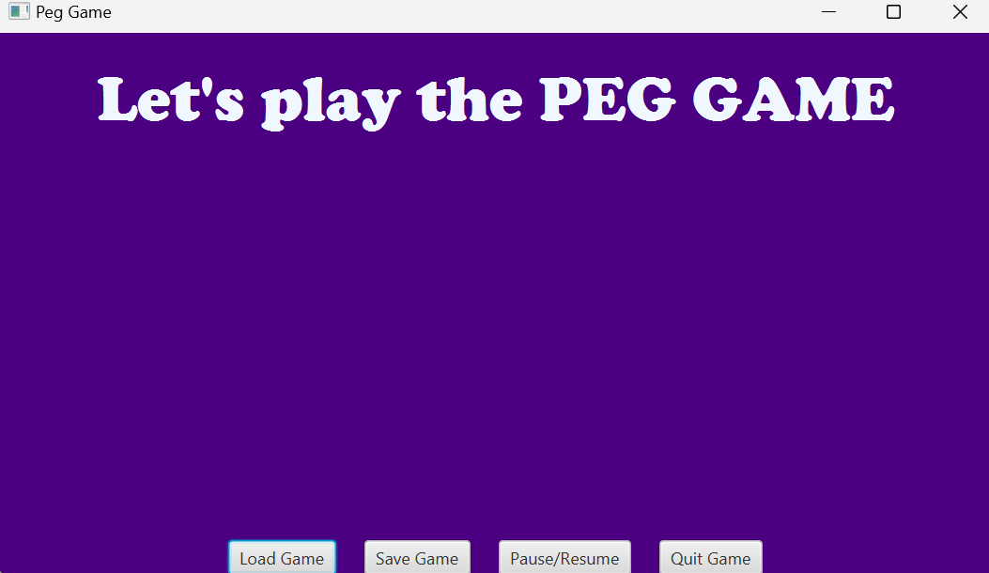
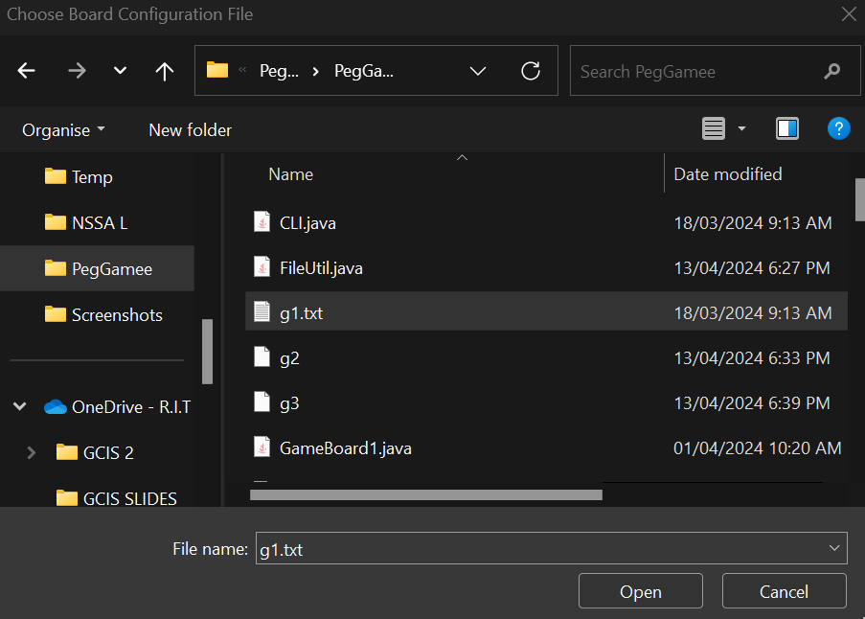
Loading the game file

Slide 5
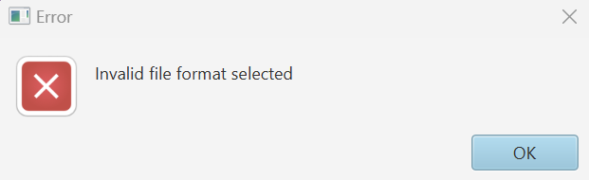
Error while loading the game file if invalid format chosen

Slide 6
ERROR HANDLING
1. **Comprehensive Error Functions**: The GUI employs two primary methods for error notification:
- **Show Error Function**: This function is specifically tailored to handle file-related issues. If there's an error while loading a game board due to an invalid file format, it promptly displays an error message. Similarly, if a game is saved in an incorrect format, this function will also trigger an error message to notify the user.
- **Alert Function**: For broader error handling, the alert function captures and displays errors through pop-up messages. This ensures that users are immediately aware of any issues.
2. **Gameplay Error Management**: During gameplay, if a player attempts to make an invalid move, the GUI responds intelligently:
- The error pop-up clearly states that the attempted move is invalid, preventing any changes to the game board configuration.
- It then advises the player to try a different move, thus maintaining the integrity of the game flow and ensuring that the player understands the correct actions to take.
3. **Immediate Notifications**: By using pop-up functions for error alerts, the GUI ensures that feedback is immediate. This approach minimizes user frustration by allowing quick correction of mistakes and helps in maintaining engagement and interest in the game.
Through these measures, our Peg Game GUI not only enhances gameplay but also educates players on proper game interaction, fostering an environment where learning and entertainment go hand in hand. This robust error handling system plays a critical role in providing a seamless and enjoyable gaming experience.

Slide 7
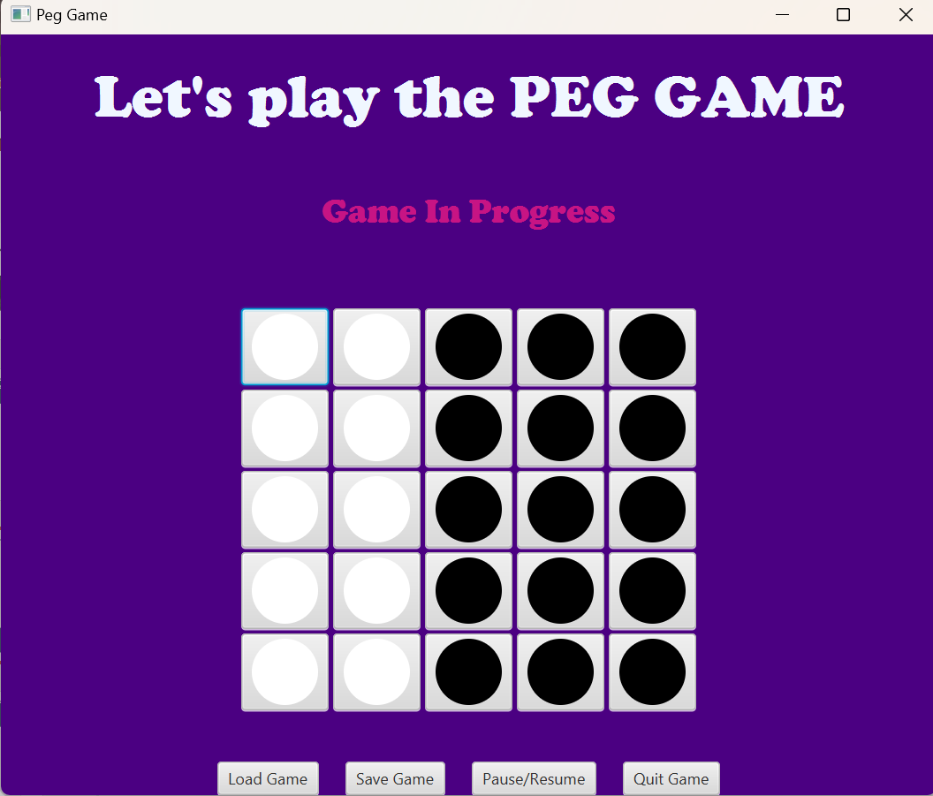
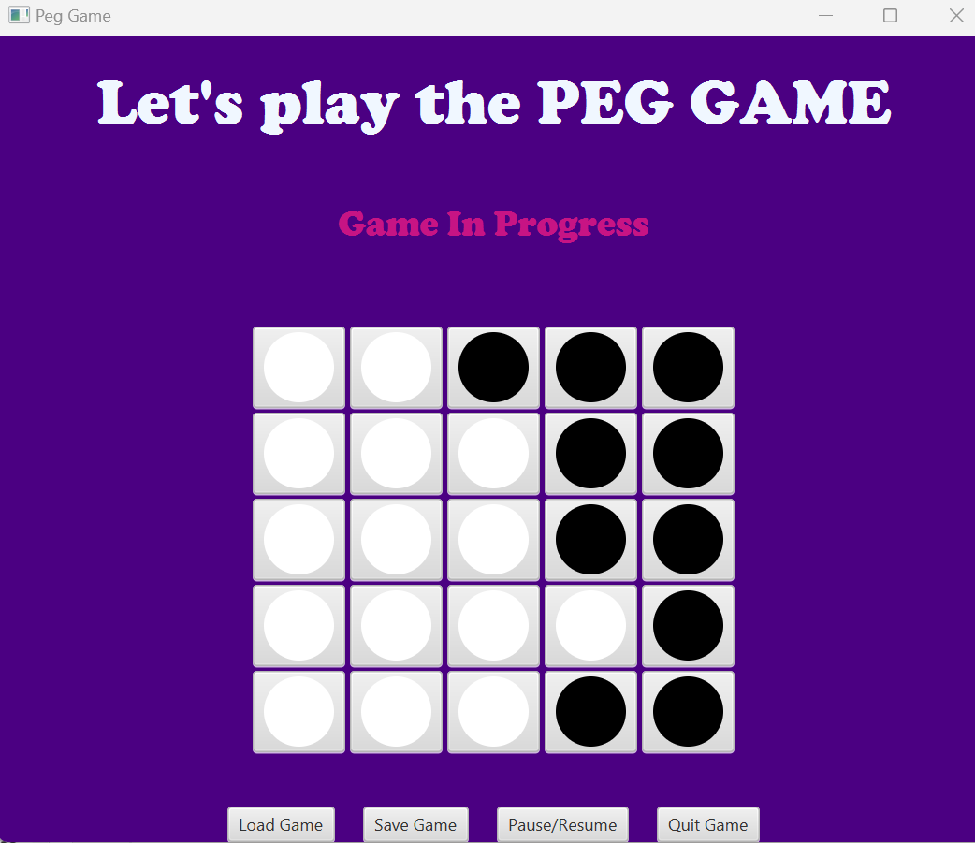
PLAYING THE PEGGAME

Slide 8
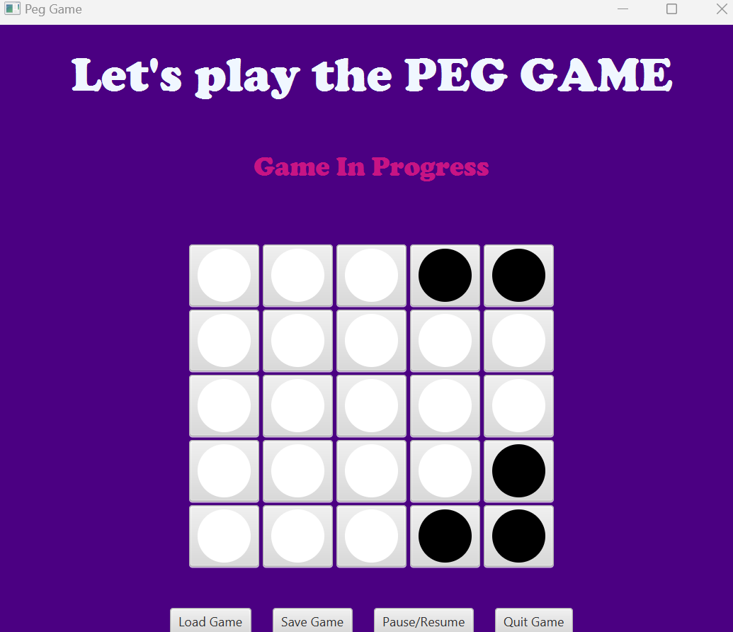
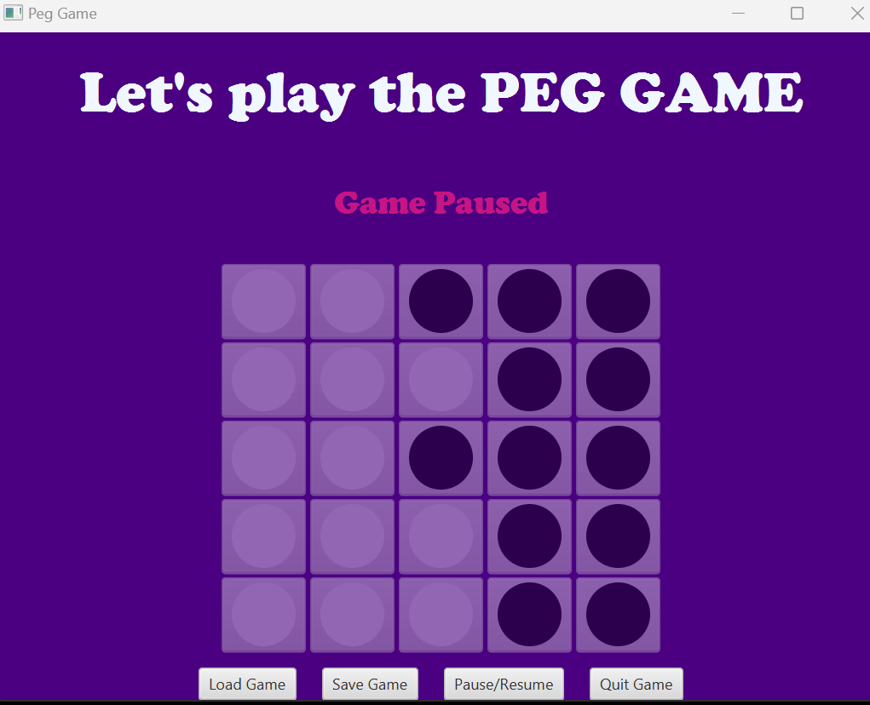
Continuation

Slide 9
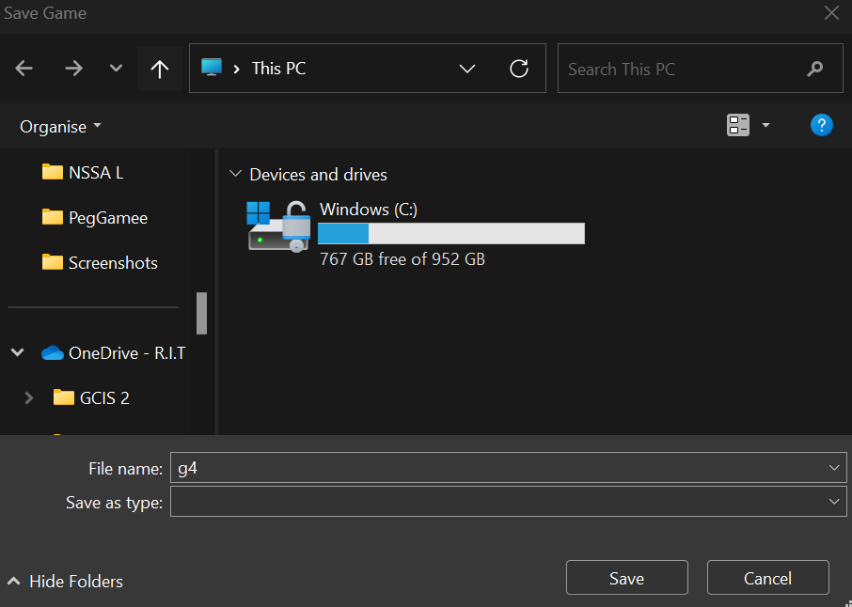
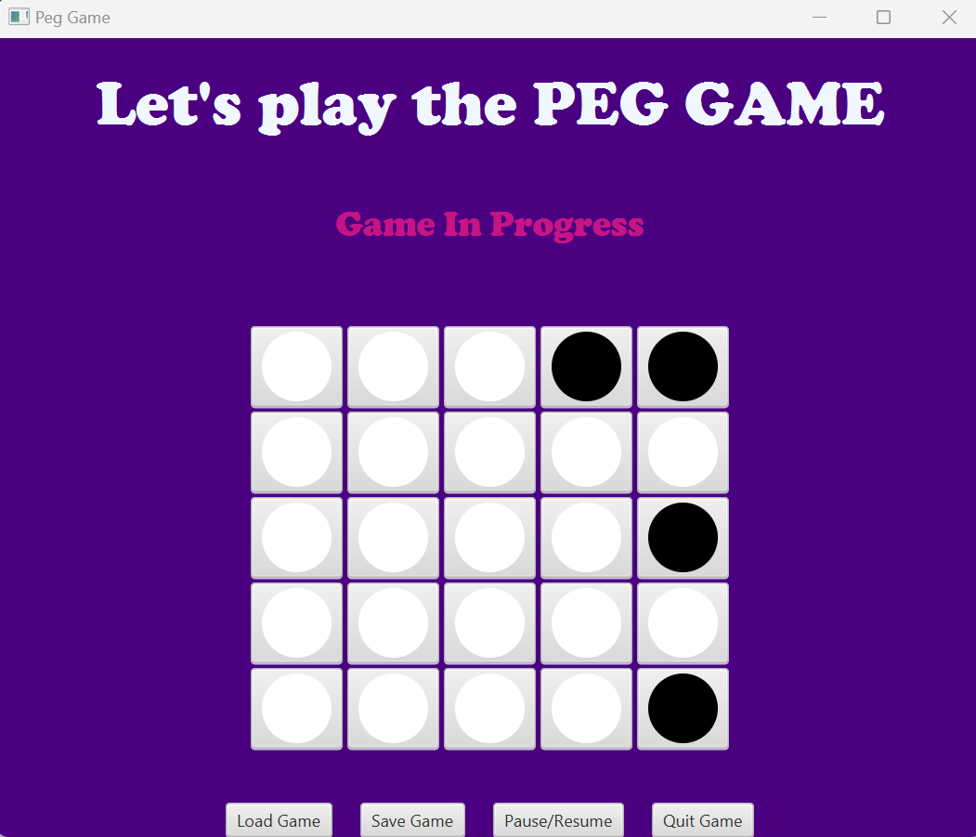
SAVING THE GAME AT ANY POINT OF TIME

Slide 10
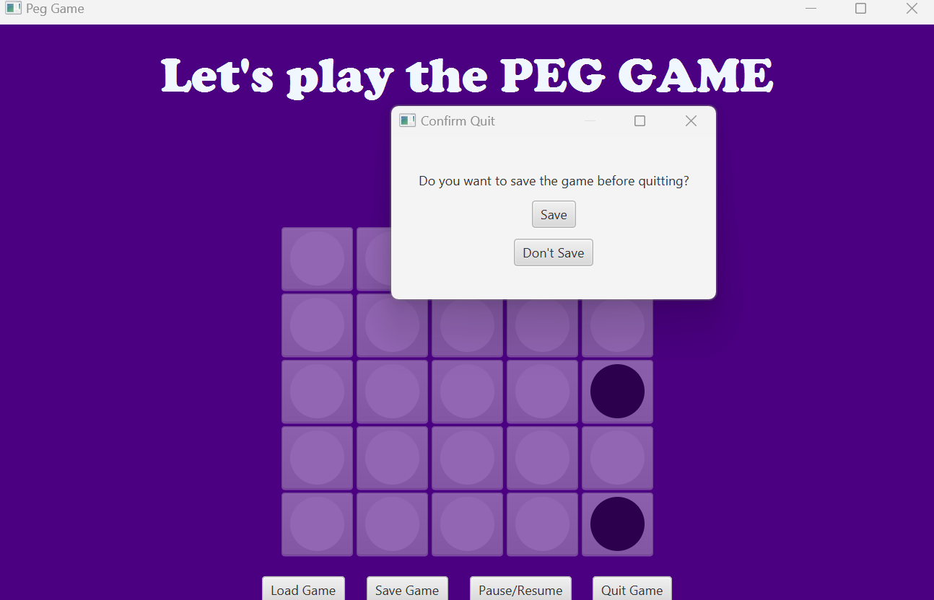
QUITTING AND SAVING THE FILE

Slide 11
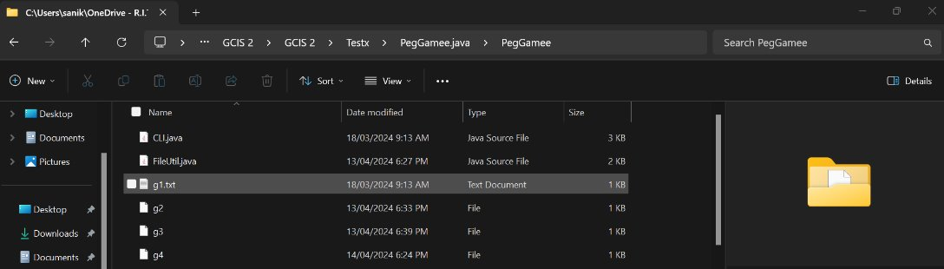
Saved txt file : g4

Slide 12
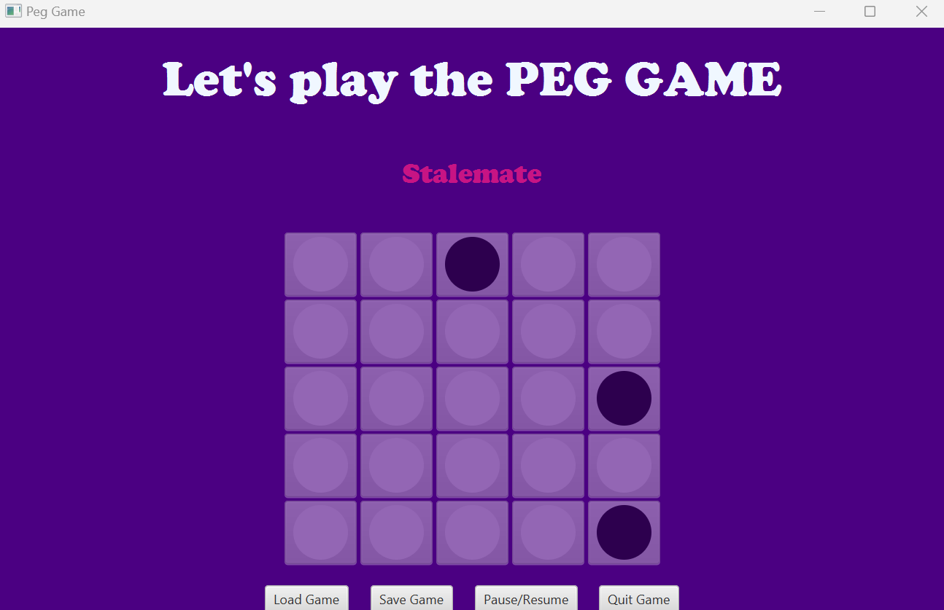
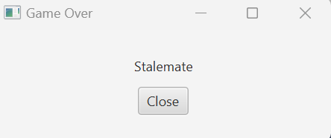
END RESULT – STALEMATE OR WIN

Slide 13

Thank You
someone@example.com

